Slide 1


KOIOS CARE
Passive Smartphone- Derived Keystroke Dynamics Analysis Using Semi- Supervised Approach
Big Blue
DATA ACADEMY

Slide 2
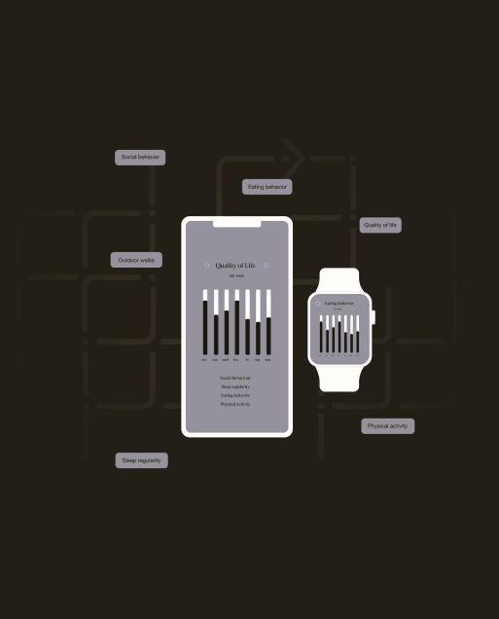

Company
HealthTech startup aiming to improve quality care for people with neuro and chronic diseases.
Daily activity biomarkers like eating/social behavior and typing patterns.

Slide 3
Project Goal
Predict keypresses and mobile display from Accelerometer Data.

Slide 4


Our Team
IOANNIS GKANIS
MARYNA BILASH
Mathematician
Industrial Design and Production
yannisgkanis@gmail.com
https://www.linkedin.com/in/i-gkanis/
bilas_m_9605@hotmail.com
https://www.linkedin.com/in/marynabilash/

Slide 5
Data Overview
Data for keypresses, accelerometer and gyroscope is collected through the use of a smartphone keyboard
~ 80 days of keyboard sessions
Different users
Every day has multiple keyboard sessions.

Slide 6
Data Structure
DAY 1
SES 1
SES 2
SES 4
SES 5
SES 3
ACCELEROMETER
GYROSCOPE
t
x
y
z
KEY PRESS
t
x
y
z
Press
(dt)
Release
(dt)

Slide 7
Challenges Solutions
Combining Data Frames
Labeling
Session Selection for effective prediction
Combining keystrokes, accelerometer and gyroscope by using resampling on timestamps.
Windowing
Accelerometer Magnitude

Slide 8
Combining the DataFrames/Labelling
Time
acc
gyr
Typing
D:T:0.02
0.31
resample
0
0.04s
0.13
-0.11
bfill()
0.06s
0.38
resample
1
0.08s
-0.4
resample
ffill()
0.10s
0.26
-0.23
0

Slide 9
Feature Creation
x
x
mean
std
...
2
2
5
5
9.7
...
...
Window Size = 1.4 s
Mean, std, energy
8
8
11.7
...
...
14
14
5
...
...

Slide 10
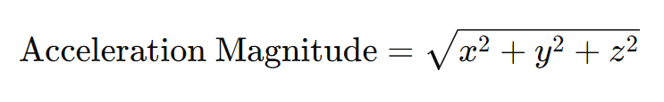
Accelerometer Magnitude for ID Session Selection
Acceleration magnitude measures the total change in speed or the force experienced, regardless of the direction of movement.
The calculation of acc magnitude components from accelometer.
Accelerometer measures 9.81 m//s² indicates that the device is stationary and is experiencing only the acceleration due to gravity.
Low mobility state of the mobile phone of the user , acceleration magnitude 9.7 - 9.9 with low std for the mean of Accelerometer Magnitude per id session.

Slide 11
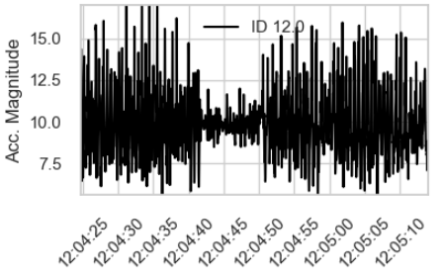
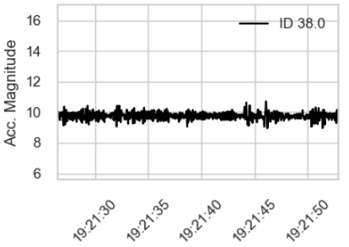
Acceleration Magnitude Graph for two different IDs

Slide 12
F1-score across different standard deviations of mean Accelerometer Magnitude for a single user
38%
75%
73%
70%
std : 0.3
std : 0.5
std : 0.8
std : 1.0
*Reminder: mean 9.7- 9.9

Slide 13
RardomForest with/without Feature Creation/ Acc Magnitude
F1 score
without
with Feature Creation
acc_magnitude with Feature Creation
65%
70%
75%
80
60
40
20
0
without
with Feature Creation
acc_magnitude

Slide 14
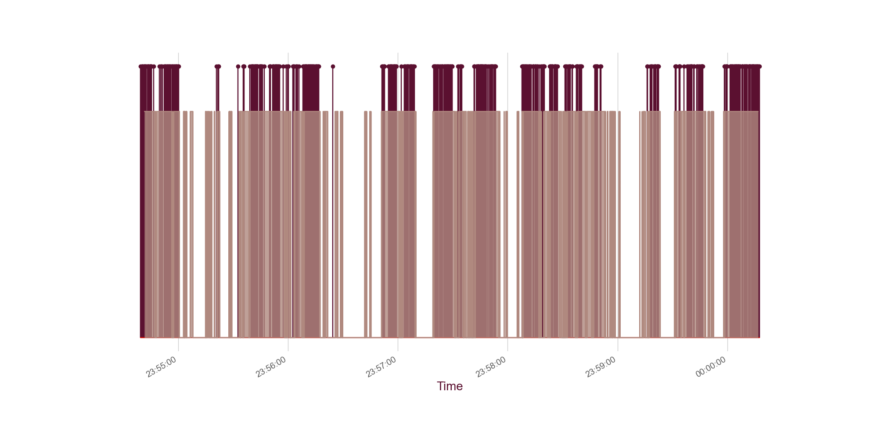
Visualizing the Results

Slide 15
Outlook
Train model using data from multiple users to avoid over fitting for a particular user.
Further preprocessing of accelerometer data may capture additional mobility user states, enhancing predictive accuracy

Slide 16

THANKS !
Q&A
Big Blue
DATA ACADEMY

